Slide 1
Deriving State…
...and an example of combining behaviour

Slide 2
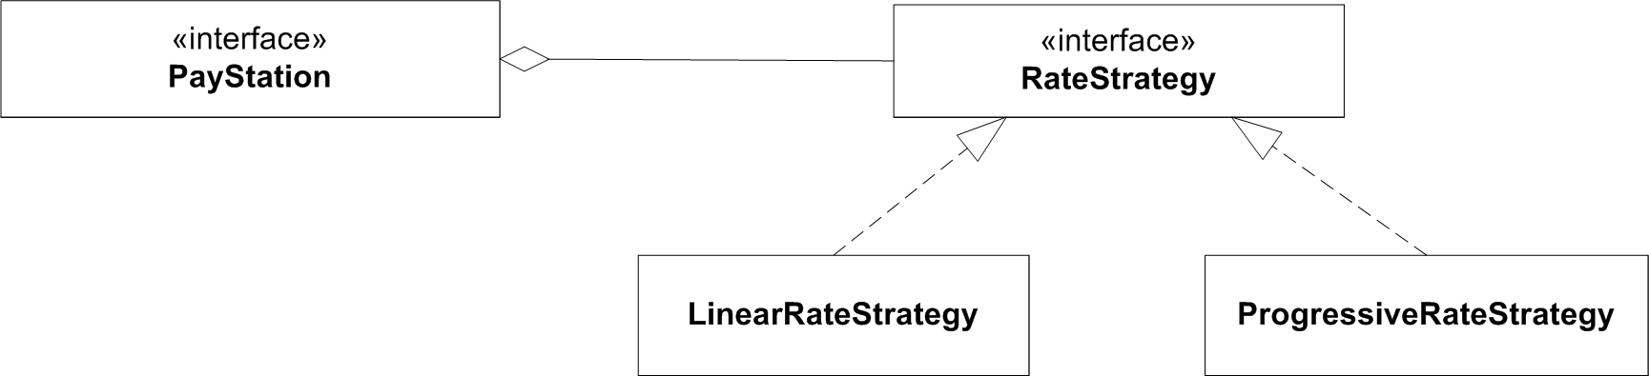
New requirement
Gammatown County wants:
“In weekdays we need Alphatown rate (linear);
in weekends Betatown rate (progressive)”
CS, AU
Henrik Bærbak Christensen

Slide 3

Exercise
“In weekdays we need Alphatown rate (linear);
in weekends Betatown rate (progressive)”
Exercise: How?
CS, AU
Henrik Bærbak Christensen

Slide 4
Same analysis
Model 1:
  Source tree copy
    Now three copies to maintain
Model 2:
  Parametric
    If ( town == alpha ) {} else if (town == beta) {} else if (town == gamma) {}
Model 3:
  Polymorphic – but ???
Model 4:
  Compositional – but how?
CS, AU
Henrik Bærbak Christensen

Slide 5
But…
I will return to the analysis shortly, but first…
I have a problem!
  I want to do TDD – because automated tests feels good…
  But how can I write test first when the outcome of a GammaTown rate strategy… depends on the day of the week???
CS, AU
Henrik Bærbak Christensen

Slide 6
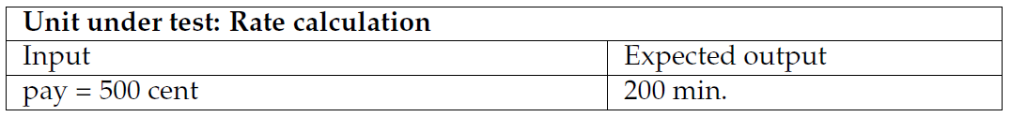
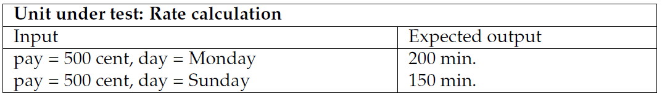
Tricky Requirement
The test case for AlphaTown:
… but how does it look for GammaTown?
CS, AU
Henrik Bærbak Christensen

Slide 7
Direct and Indirect Parameters
The day of the week is called an indirect parameter to the calculateTime method
  It is not an instance variable of the object
  It is not a parameter to the method
  It cannot be set by our JUnit code ☹
CS, AU
Henrik Bærbak Christensen

Slide 8
Solutions?
So – what to do?
  Come in on weekends?
    Manual testing!
  Set the clock ?
    Manual testing!
    Mess up Ant as it depends on the clock going forward!
  Refactor code to make Pay Station accept a Date object?
    No – pay stations must continously ask for date objects every time a new coin is entered…
I will return to this problem set soon…
CS, AU
Henrik Bærbak Christensen

Slide 9
Polymorphic Solutions to the GammaTown Challenge

Slide 10
Premise
Let us assume that we have developed the polymorphic solution to handle BetaTown!
That is, forget the nice Strategy based solution we did last time ☺
CS, AU
Henrik Bærbak Christensen

Slide 11
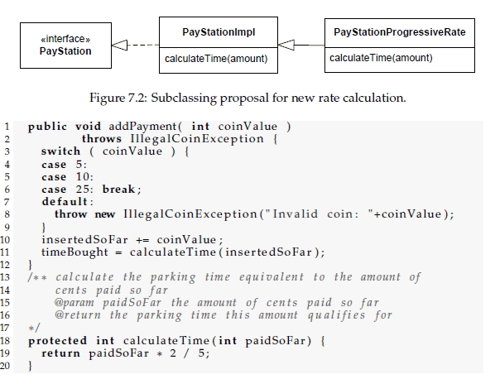
Revisited
How did
it look?
CS, AU
Henrik Bærbak Christensen

Slide 12
So...
Given this:
How to make a subclass that reuse the calculateTime implementations of two different classes in the class hierarchy?
Actually, we can do this in quite a number of ways
CS, AU
Henrik Bærbak Christensen

Slide 13
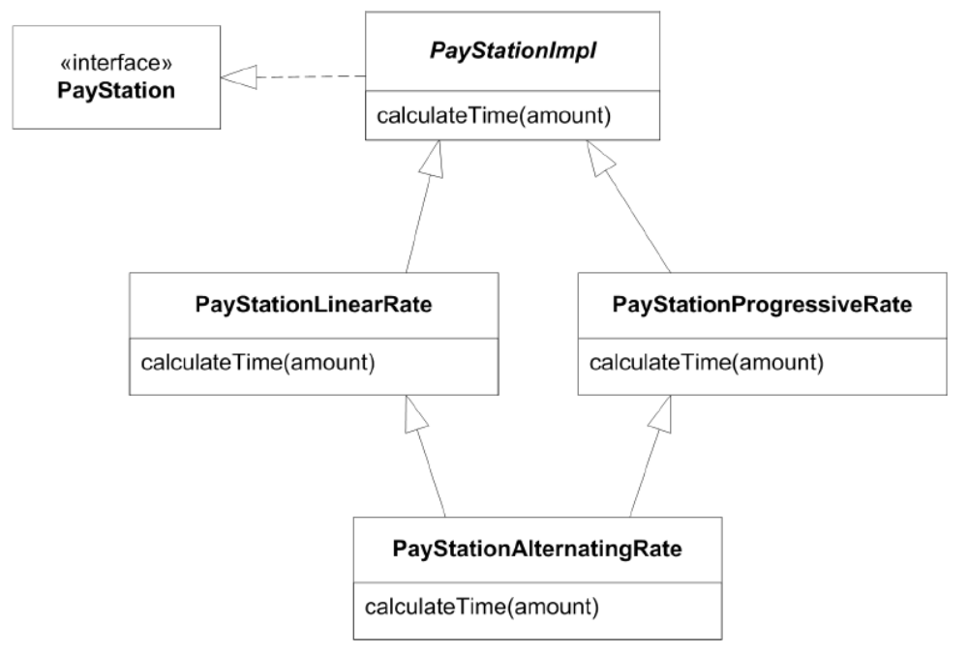
Model 3a: Multiple Inheritance
Subclass and override!
Could work in C++, but not Java or C#;
  experience with join-hierarchies in C++ are bad ☹
CS, AU
Henrik Bærbak Christensen

Slide 14
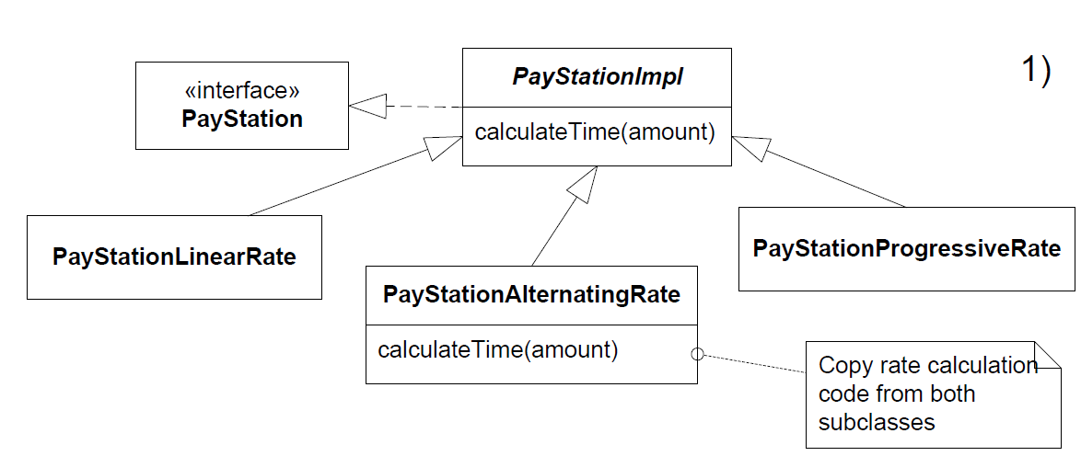
Model 3b: Direct Subclass
Cut code from liniear and progressive, paste into alternating
CS, AU
Henrik Bærbak Christensen

Slide 15
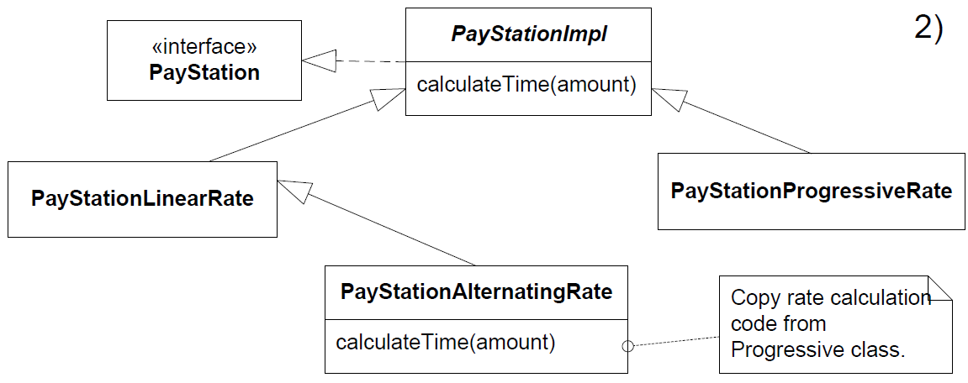
Model 3c:Sub-sub Class
Cut code from progressive, paste into alternating
CS, AU
Henrik Bærbak Christensen

Slide 16
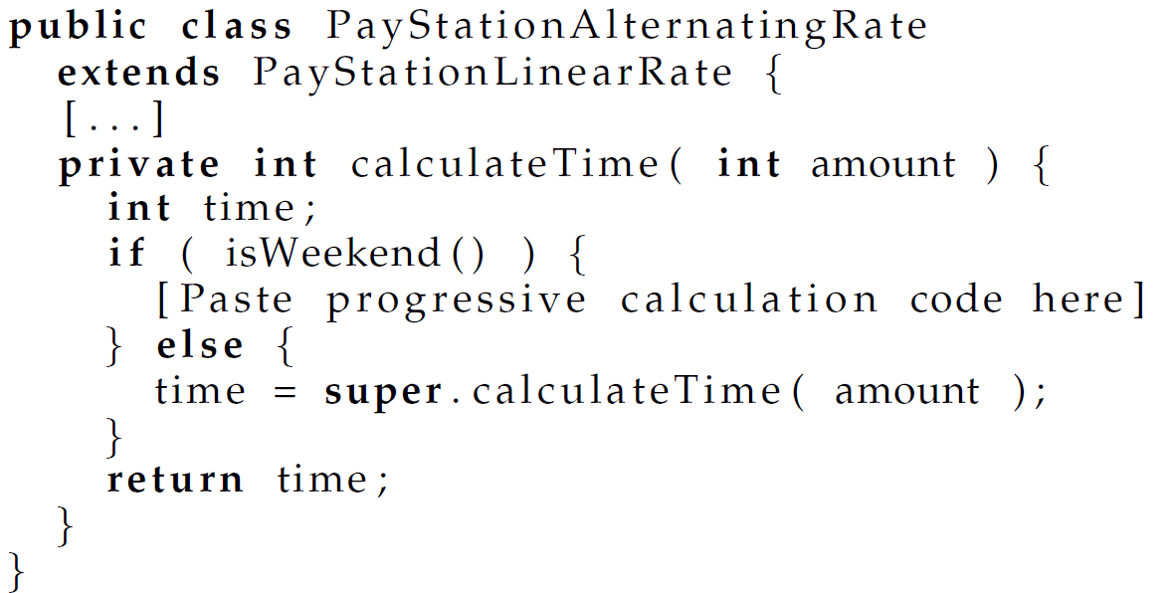
Code view
CS, AU
Henrik Bærbak Christensen

Slide 17
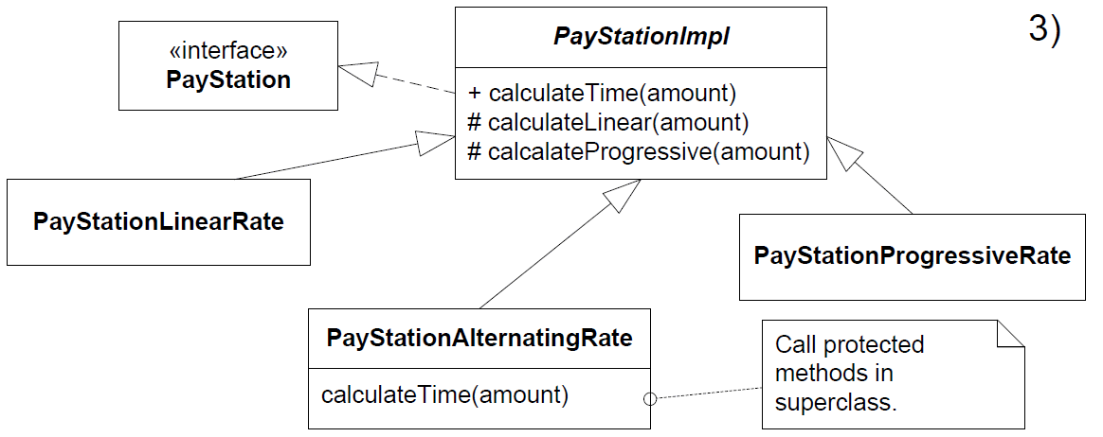
Model 3d: Bubbling up/Superclass
Make protected calculation methods in abstract PayStationImpl, and call these from Alternating
  This is a classic solution often seen in practice
CS, AU
Henrik Bærbak Christensen

Slide 18
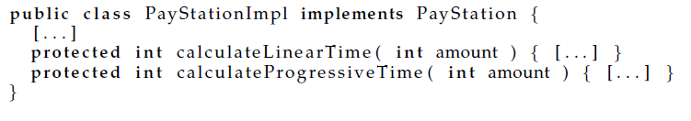
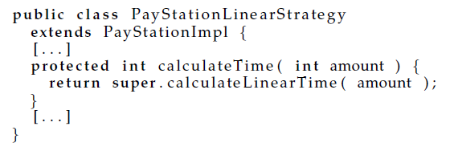
Code view
The super class
Alpha
CS, AU
Henrik Bærbak Christensen

Slide 19
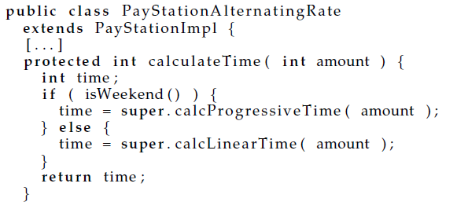
Code view
Gamma
Discussion
  No code duplication
  Exercise: what are the liabilities?
CS, AU
Henrik Bærbak Christensen

Slide 20
Liabilities
Superclass maintainability
  Becomes a junk pile of methods over time
  The methods are unrelated to the superclass itself, it is just a convenient parking lot for them
  This is an example of an abstraction with little cohesion
  Grave yard of forgotten methods?
CS, AU
Henrik Bærbak Christensen

Slide 21

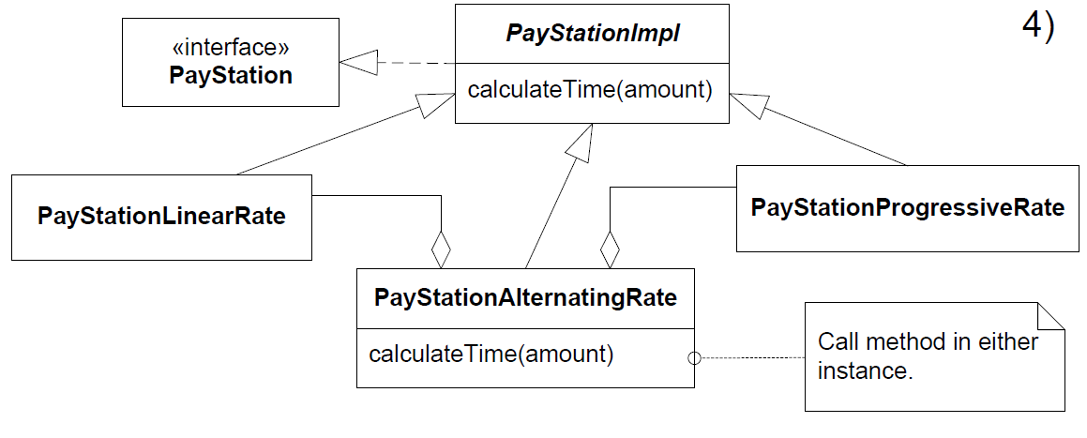
Model 3e: Stations in Stations
CS, AU
Henrik Bærbak Christensen

Slide 22
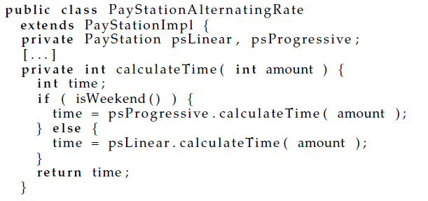
Model 3e: Stations in Stations
The “pay stations in pay station” way:
  Create an gamma pay station containing both an alpha and beta pay station
Exercise: Benefits and liabilities?
CS, AU
Henrik Bærbak Christensen
Notes:
Solves the problem
Multiple states to keep consistent
Does not really match my intuition of reality
More space consumption in memory

Slide 23
Compositional Variants

Slide 24
Premise
Now, please reset your minds!
We now look at the compositional variant (strategy pattern) that we made the last time!
CS, AU
Henrik Bærbak Christensen

Slide 25
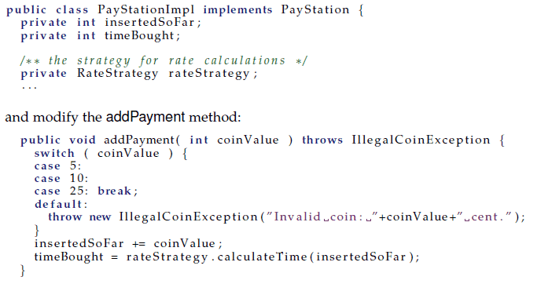
Code View (Java)
DAIMI
Henrik Bærbak Christensen

Slide 26
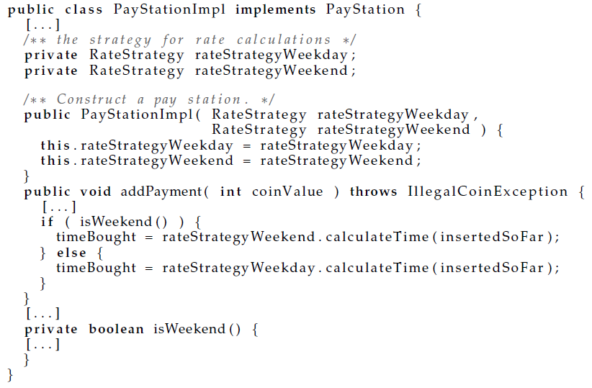
Model 4a: Parameter + compositional
CS, AU
Henrik Bærbak Christensen

Slide 27
Model 4a: Parameter + compositional
Liabilities
  Code change in the constructor
  Constructor has become really weird for alpha and beta
Worse: we have just blown the whole idea!
  now the pay station has resumed the rate calculation responsibility 
  or even worse – the responsibility is distributed over several objects   
    The responsibility to know about rate calculations are now distributed into two objects – leading to lower analyzabilty
    leads to duplicated code, and bugs difficult to track.
CS, AU
Henrik Bærbak Christensen

Slide 28
Model 4b: Copy and paste version
Cut and paste the code into new strategy object
Multiple maintenance problem 
  a bug in price calculation functionality must be corrected in two places – odds are you only remember one of them.
GammaAlternatingRateStrategy
CS, AU
Henrik Bærbak Christensen

Slide 29
… on to a nice compositional solution: State pattern

Slide 30
Compositional Idea
③ I identify some behaviour that varies.
  The rate calculation behaviour is what must vary for Gammatown and this we have already identified.
① I state a responsibility that covers the behaviour that varies and encapsulate it by expressing it as an interface.
  The RateStrategy interface already defines the responsibility to “Calculate parking time” by defining the method calculateTime.
② I compose the resulting behaviour by delegating the concrete behaviour to subordinate objects.
  This is the point that takes on a new meaning concerning our new requirement.
CS, AU
Henrik Bærbak Christensen

Slide 31
Model 4
Compose the behaviour...
That is:
  the best object to calculate linear rate models has already been defined and tested – why not use its expertise ? Same goes with progressive rate.
  so let us make a small team – one object responsible for taking the decision; the two other responsible for the individual rate calculations.
CS, AU
Henrik Bærbak Christensen

Slide 32



The Cartoon
Team leader
rate calculation request
Rate Policy Expert
Linear
2.delegate to expert
1. check clock
Rate Policy Expert
Progressive
CS, AU
Henrik Bærbak Christensen

Slide 33

Interpretation
Note:
From the Pay Station’s viewpoint the behaviour of the ”team leader” change according to the state of the clock!
Pay Station
Team leader
rate calculation request
CS, AU
Henrik Bærbak Christensen

Slide 34
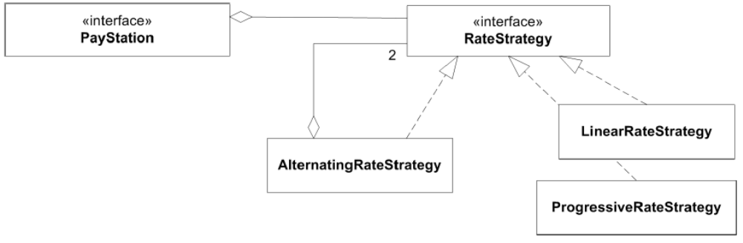
Clock State Define Behavior
Reusing existing, well tested, classes...
CS, AU
Henrik Bærbak Christensen

Slide 35
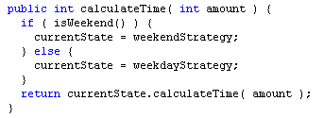
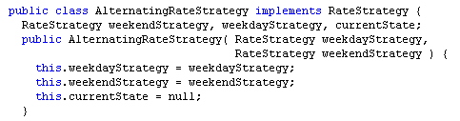
Code view
In AlternatingRateStrategy:
1. check clock
2.delegate to expert
In AlternatingRateStrategy: Construction
CS, AU
Henrik Bærbak Christensen

Slide 36
Analysis
Consequence:
  Minimal new code, thus very little to test
    most classes are untouched, only one new is added.
  Change by addition, not modification
  No existing code is touched
    so no new testing
    no review
  Parameterization of constructor
    All models possible that differ in weekends...
CS, AU
Henrik Bærbak Christensen

Slide 37
Roles revisited
This once again emphasizes the importance of
  ③ Encapsulate what varies: the rate policy
  ① Define well-defined responsibilities by interfaces
  ① Only let objects communicate using the interfaces
    Then the respective roles (pay station / rate strategy) can be played by many difference concrete objects
    And each object is free to implement the responsibilities of the roles as it sees fit – like our new ‘team leader’ that does little on his own!
  ② also to let most of the dirty job be done by others ☺
CS, AU
Henrik Bærbak Christensen

Slide 38
The State Pattern

Slide 39
Analysis
Yet another application of 3-1-2
  (but note that the argumentation this time was heavily focused on the ② aspect: composing behaviour by delegating to partial behaviour)
Rephrasing what the Gammatown pay system does:
  The rate policy algorithm alters its behaviour according to the state of the system clock
CS, AU
Henrik Bærbak Christensen

Slide 40
State Pattern
State pattern intent
  Allow an object to alter its behaviour when its internal state changes. The object will appear to change its class.
  The rate policy algorithm alters its behaviour according to the state of the system clock
  Seen from the PayStationImpl the AlternatingRateStrategy object appears to change class because it changes behaviour over the week.
CS, AU
Henrik Bærbak Christensen

Slide 41
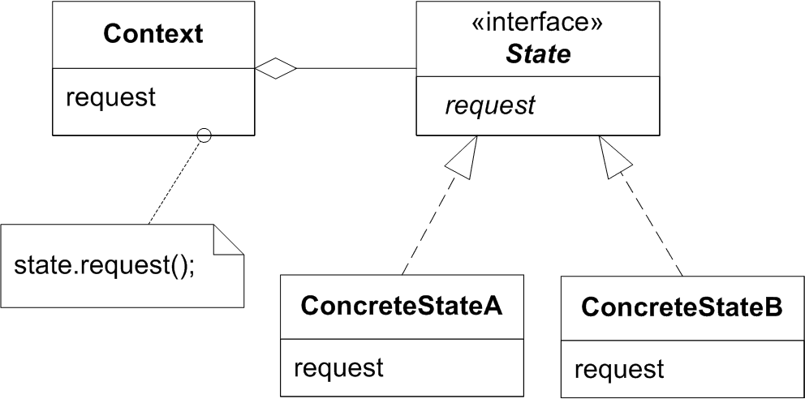
Roles
Context delegate to its current state object
State specifies responsibilities of the behaviour that varies according to state
ConcreteState defines state specific behaviour
State changes?
  May be defined either in Context or in ConcreteState set
  That who defines it is less reusable
CS, AU
Henrik Bærbak Christensen

Slide 42
Exercise
Which object/interface fulfil which role in the pay station?
Who is responsible for state changes?
CS, AU
Henrik Bærbak Christensen

Slide 43
Benefits/Liabilities of State
General
  State specific behaviour is localized
    in a single ConcreteState object
  State changes are explicit
    as you just find the assignments of ‘currentState’
  Increased number of objects
    as always with compositional designs
Compare common statemachines:
  case INIT_STATE:
  case DIE_ROLL_STATE:
CS, AU
Henrik Bærbak Christensen

Slide 44
Examples
All state machines can be modelled by the state pattern
  and looking for them there are a lot
  TCP Socket connection state
  any game has a state machine
  Protocols
  etc...
CS, AU
Henrik Bærbak Christensen

Slide 45
Summary
New requirement
  a case that screams for reusing existing and well-tested production code
  cumbersome to utilize the reuse potential especially in the subclassing case (deeper discussion in the book)
  but handled elegantly by compositional design
    think in terms of teams of objects playing different roles
  I derived the State pattern
    more general pattern handling state machines well
CS, AU
Henrik Bærbak Christensen

